Slide 1

DetactaX AI (AI Vision Platform)
DEPI Round 3 Graduation Project

Slide 2

Project team:
Zyad Gamal (team leader): Azure Integration & API Deployment.
Basel Mohamed: Both Classification Models Designer, Mlflow, and Project Documentation.
Omar Yasser: Project Models Interface GUI using Streamlit.
Mohamed Hamada: Object Recognition Model.
Zyad Ahmed: Dataset Acquisition & Augmentations.
Abdulrahman Kamal: Baseline Classifier Transfer Learning.

Slide 3
Abstract:
Existing tools are complex or slow and require technical expertise.
Users need:
1. Easy-to-use interface
2. Quick predictions
3. High accuracy
4. No technical setup required
- Project Idea: Making a website with both Image Classification & Object Recognition capabilities for multi-use cases.
- Goal: Quickly and accurately classify the main object in an image & recognize multiple objects using top of the line models.

Slide 4
Introduction:
Our project is not just a classifier or a detector. We provide a complete Solution platform that combines image classification, object detection, real-time analysis, Grad-CAM visualization, reporting, and Azure endpoints.
The main goal is to offer a general visual data preparation system that any AI team can build advanced applications on top of, such as:
Security and surveillance
Traffic analysis
Industrial analytics
Product analysis
Sorting systems
Healthcare pre-screening
Research dataset generation

Slide 5
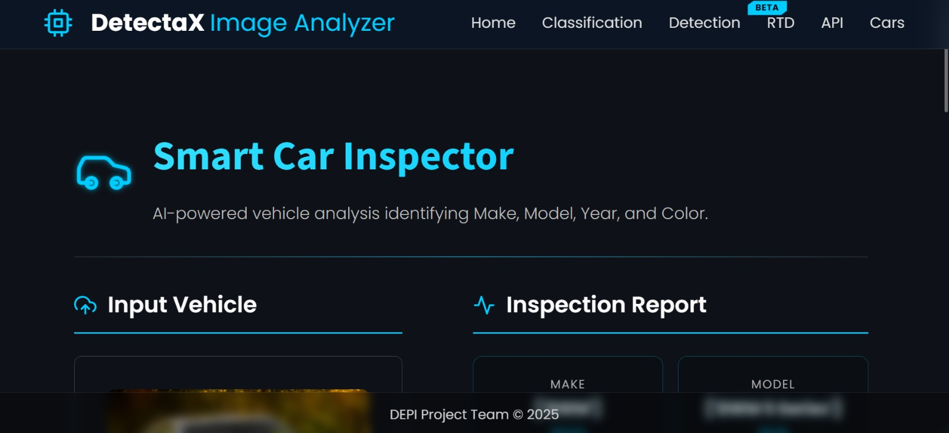
Services Offered:
Image upload
Data cleaning
Object extraction
Classification
Result exporting
Grad-CAM visualization
PDF reports
JSON / CSV export
Real-time feed
This makes the platform ready for downstream tasks.

Slide 6
CIFAR-10 Classifier Dataset

Slide 7
General Classifier (Base-line/Control):
Full Name: Canadian Institute For Advanced Research (CIFAR) - 10 classes.
Creators: Alex Krichevsky, Vinod Nair, and Geoffrey Hinton (University of Toronto).
Purpose: A standard benchmark for evaluating image classification algorithms, specifically Convolutional Neural Networks (CNNs).
Data Specifications:
Total Volume: 60,000 labeled images.
Training Set: 50,000 images (5 batches of 10k).
Test Set: 10,000 images (1 batch of 10k).
Dimensions: Low-resolution 32 x 32 Pixels.
Format: Color images with 3 channels (RGB).

Slide 8
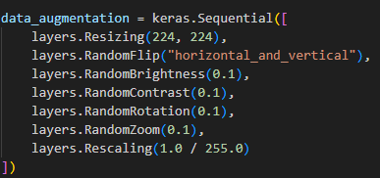
General Classifier (Base-line/Control):
Augmentations Applied on the Dataset:
Resizing to 224x224.
Random Flip Horizontal and Vertical.
Random Brightness.
Random Contrast.
Random Rotation.
Random Zoom.
Rescaling (1/255).

Slide 9
Applied Transfer Learning

Slide 10
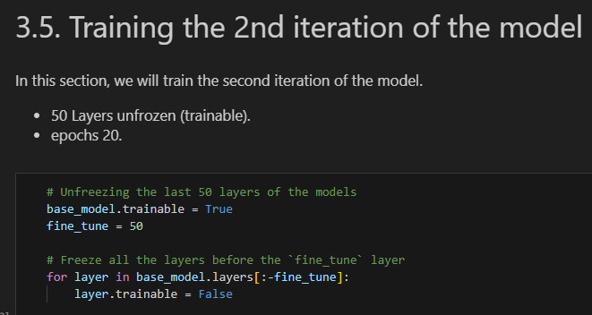
Transfer Learning
Applied transfer learning on
Baseline/model (MobileNetV2).
Freezing all layers before the final
Layer

Slide 11
Classification Models

Slide 12
Technology Stack & Versions
Requests 2.31.0
Matplotlib 3.7.2
Plotly 5.15.0
Kaleido 0.2.1
Ultralytics 8.1.0
Torch 2.1.0
Python 3.12
Streamlit 1.28.0
OpenCV 4.8.1.78
Pillow 10.0.1
NumPy 1.24.3
11/29/2025

Slide 13
Classifiers:
Models used:
1. MobileNetV2.
2. EfficientNet-B0.
Both models are employed for different use-cases in our project, where:
MobileNetV2 is used as a baseline test general classifier.
EfficientNet-B0 used for Intelligent Transportation systems.

Slide 14
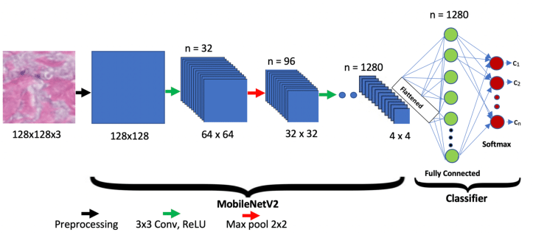
Baseline General Classifier:
Model Used: MobileNetV2 trained on CIFAR-10 Dataset.
MobileNetV2 released by google is a very light weight yet efficient model released mainly for Mobile & Embedded systems applications.
Important three points:
1. Inverted Residuals.
2. Linear Bottlenecks.
3. Highly Efficient.

Slide 15
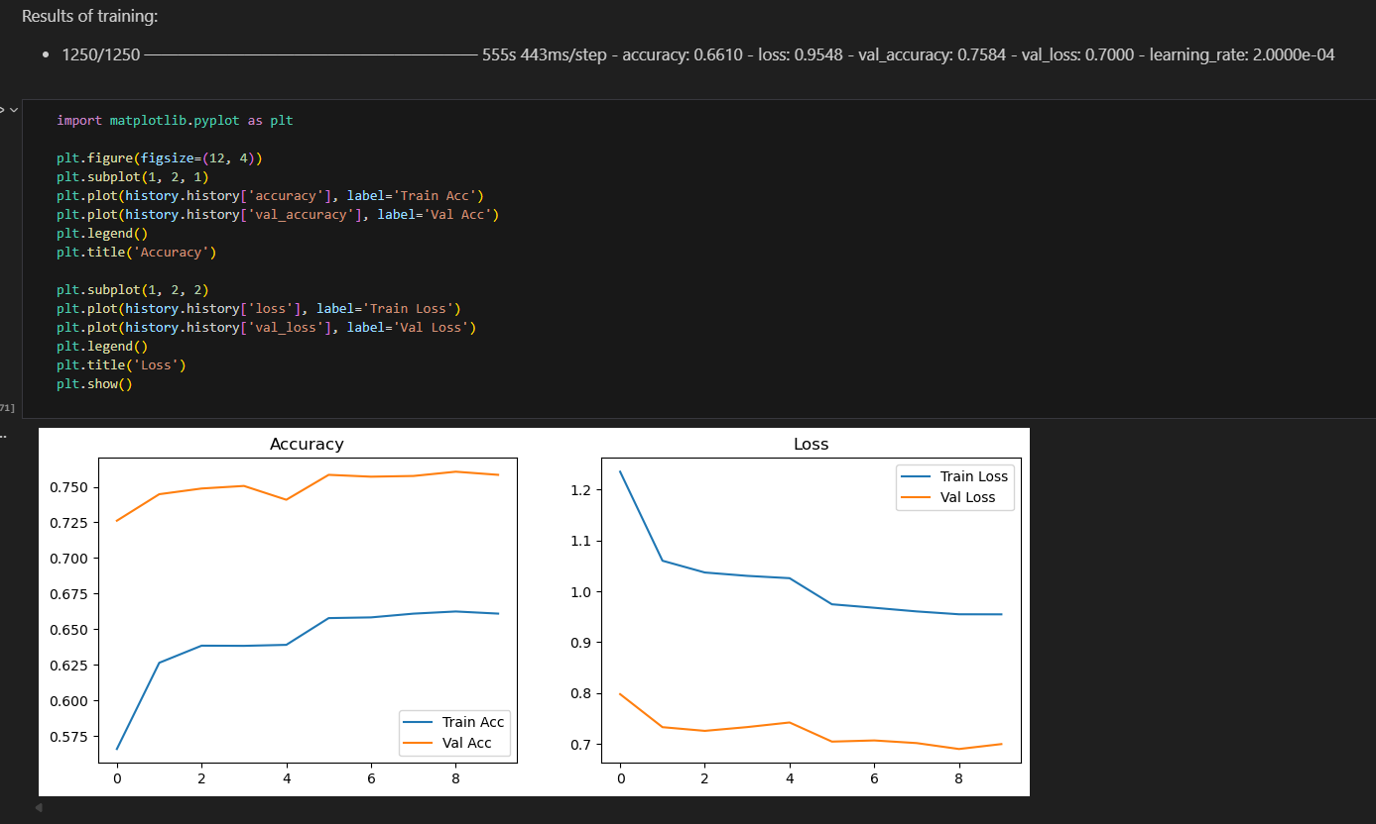
Baseline General Classifier Training:
Trained the model two times, each time with different hyperparameters and more aggressive training cycles.
First Training Cycle:
1. 10 epochs.
2. All layers frozen.
2. Accuracy: 0.6610.
3. Loss: 0.9548.
4. Validation Accuracy
: 0.7584.

Slide 16
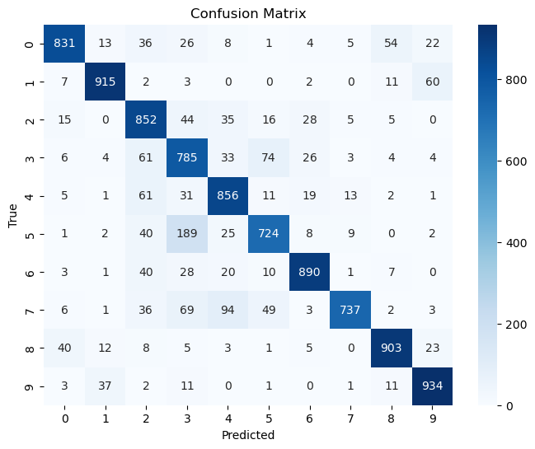
Baseline General Classifier Training:
Trained the model two times, each time with different hyperparameters and more aggressive training cycles.
Second Training Cycle:
1. 50 epochs.
2. Unfreeze last 50 layers.
3. Accuracy: 0.8451
4. Loss: 0.4446
5. Validation Accuracy: 0.8404

Slide 17
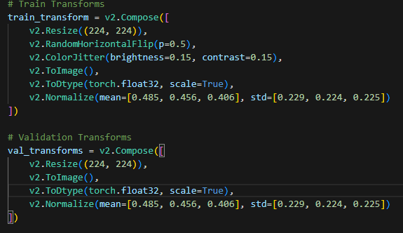
Intelligent Transportation System (Main Classifier):
Model Used: EfficientNet-B0 trained on the CUHK-Compcars dataset.
Dataset Details:
Contains 163 car makes with 1,716 car models. There are a total of 136,726 images. The full car images are labeled with bounding boxes and viewpoints.
Augmentations Applied:
1. Image Resize.
2. Color Jitter.
3. Normalization
4. Random Horizontal Flipped.

Slide 18
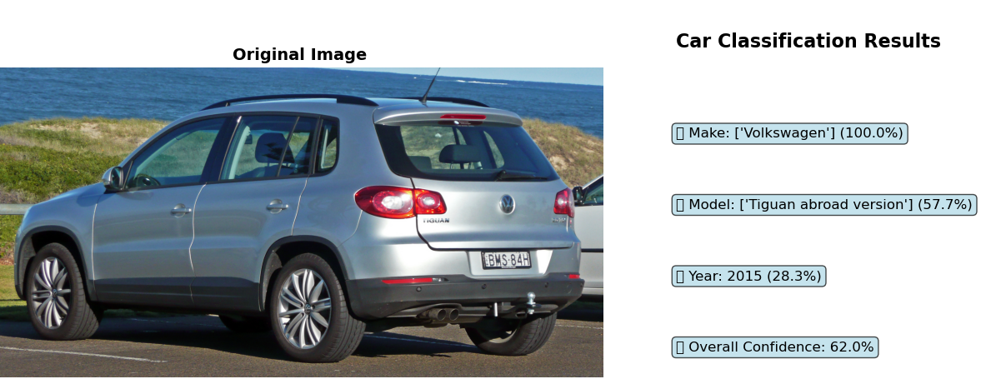
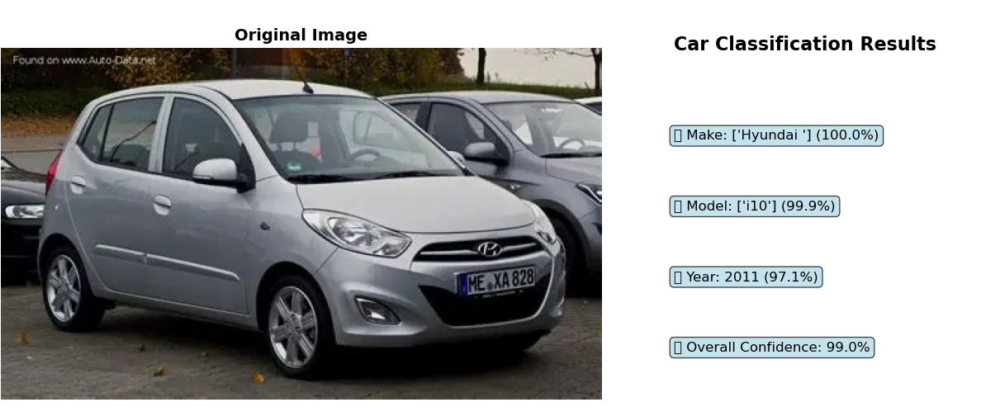
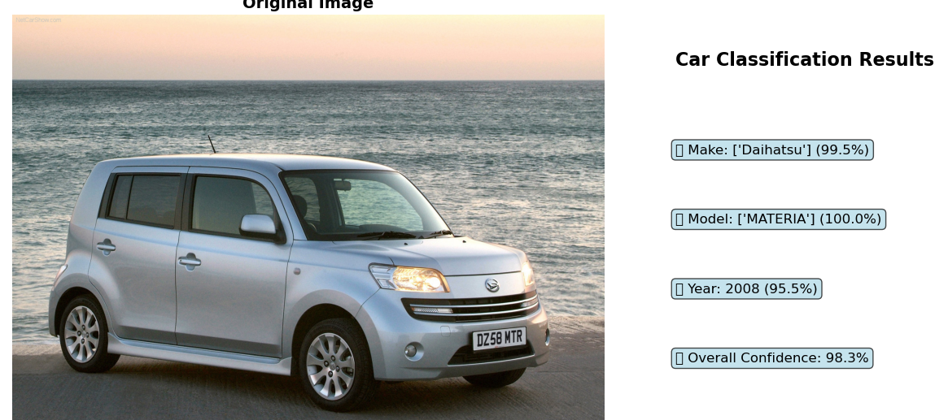
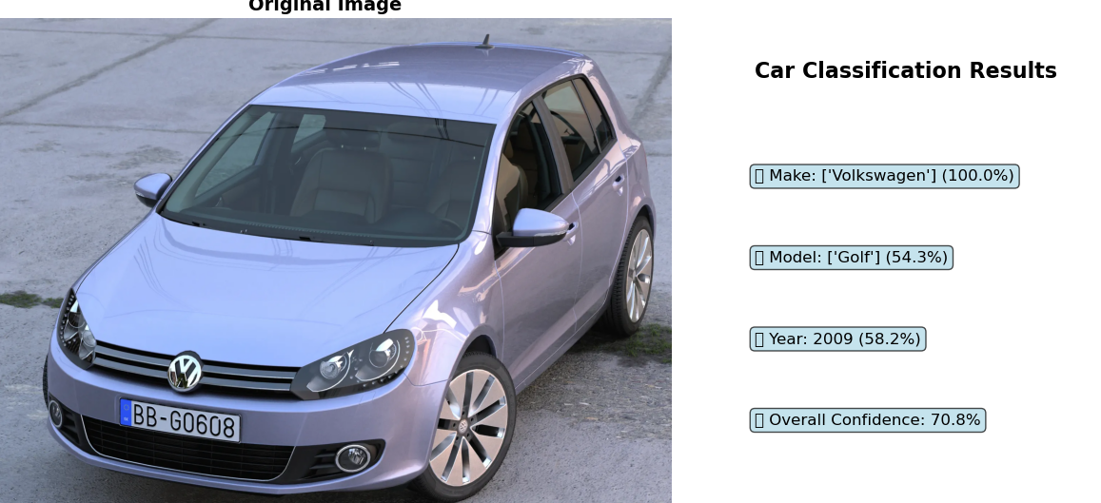

Slide 19
Models Specifications:
Training Cycles:
50 Epochs training cycle with Validation stages in-between for Baseline Classifier (MobileNetV2), Training Took about 6 Hours.
18 Epochs training cycle with Validation stages in-between for Main Car Classifier (EifficientNet-B0), Training took about 11 Hours.
Final Models Results:
Accuracy: 0.8451, Loss: 0.4446, Val Accuracy: 0.8404.

Slide 20
Object Recognition Model

Slide 21
Model Details:
Object Detection system using a pre-trained YOLO model (yolov12x.pt) from the Ultralytics library. The goal was to build a model capable of detecting and classifying multiple objects in images with high accuracy and fast inference speed.
Model Setup and Evaluation
to measure its performance. The evaluation automatically generated detection results and key metrics including:
mAP@0.5 – Measures the overlap quality between predicted and ground-truth bounding boxes.
mAP@0.5:0.95 – A stricter score averaged across 10 IoU thresholds.
Precision – Percentage of predicted boxes that are correct.
Recall – Percentage of actual objects successfully detected.
These metrics provide a full understanding of both accuracy and robustness of the object detection model.

Slide 22
Model Details:
Key Code Operations:
1)Load YOLO model:
model = YOLO("yolov12x.pt")
2) Run validation on COCO128:
metrics = model.val(data="coco128.yaml", imgsz=640)
3) Display sample detection results:
display(Image(filename=img_path))
4) Export structured performance report:
with open("model_evaluation_report.txt", "w") as f:
f.write(report)]
11/29/2025

Slide 23
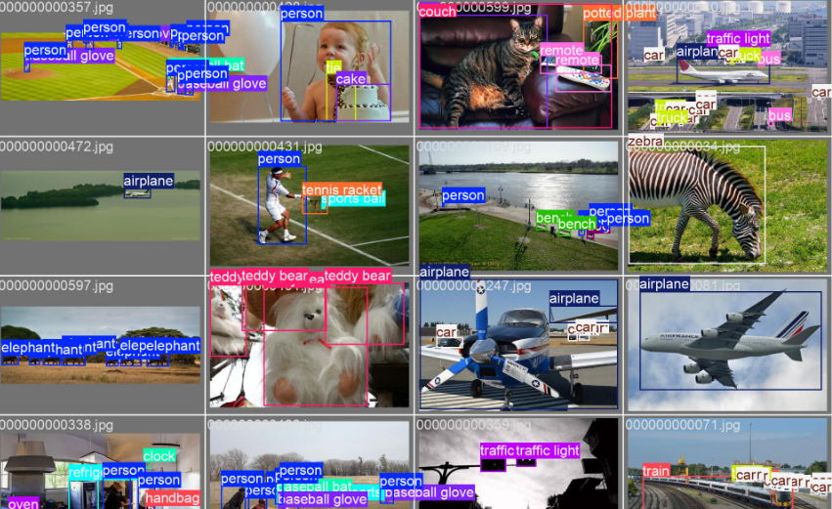
Summary
The YOLOv12x model successfully completed object detection on the validation data, generating reliable performance scores and visual outputs. The evaluation report summarizes the model’s strength in identifying objects with strong precision the project requirements for a trained and evaluated object detection system.
and recall, meeting
11/29/2025

Slide 24
Mlflow

Slide 25
Key Mlflow Components:
MLflow: Central experiment tracker.
Local SQLite: Development tracking database.
Custom Monitors: Production performance tracking and metrics documenting.
Azure Integration: Cloud deployment bridge for easy model redeployment to Azure.

Slide 26
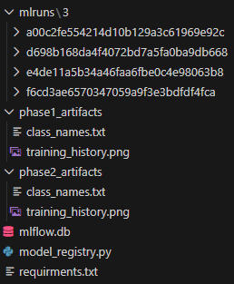
Results & Metrics:
Classification Model Performance
1. Final Test Accuracy: 82%
2. Training Time: ~60 minutes (with MLflow tracking)
3. Model Versions: 3+ registered versions
4. Experiments Tracked: 10+ complete runs
Monitoring System
1. Prediction Tracking: Real-time with <100ms overhead
2. Data Collected: Parameters, metrics, artifacts, predictions

Slide 27
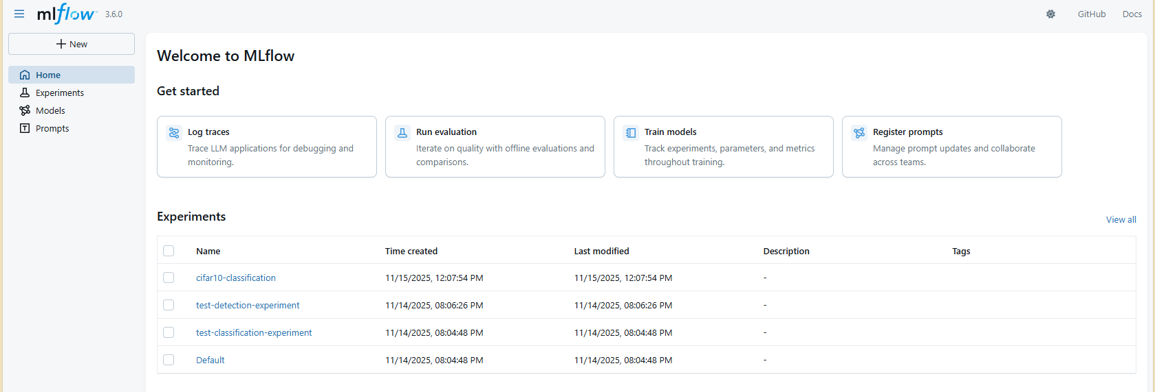

Slide 28
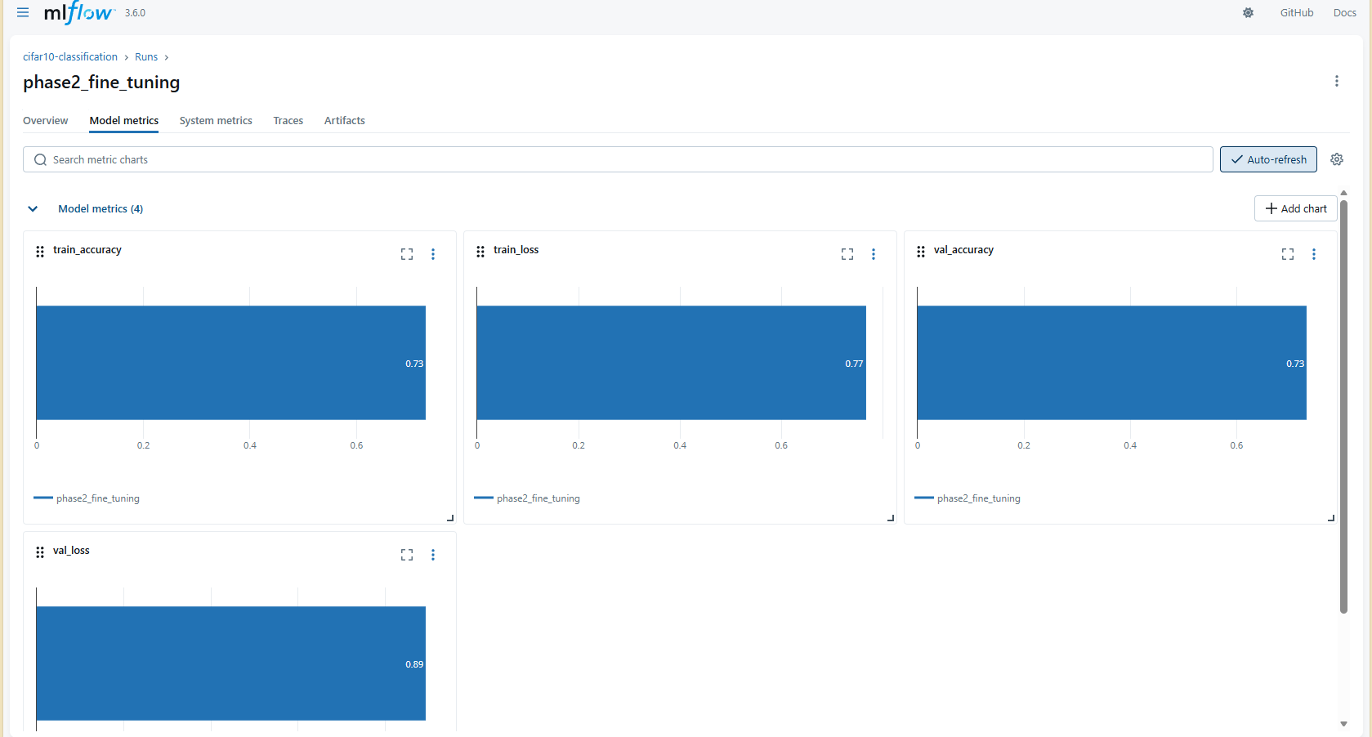

Slide 29

Model Deployment
11/29/2025

Slide 30
Why Deploy?
Make the model accessible to real users.
Deliver predictions instantly and at scale.
Integrate the system into real workflows.
Ensure consistent, reliable performance.
11/29/2025

Slide 31
Why Azure?
Reliable cloud infrastructure.
Easy model deployment with Azure ML.
Scalable compute for heavy workloads.
Built-in security and compliance.
11/29/2025

Slide 32
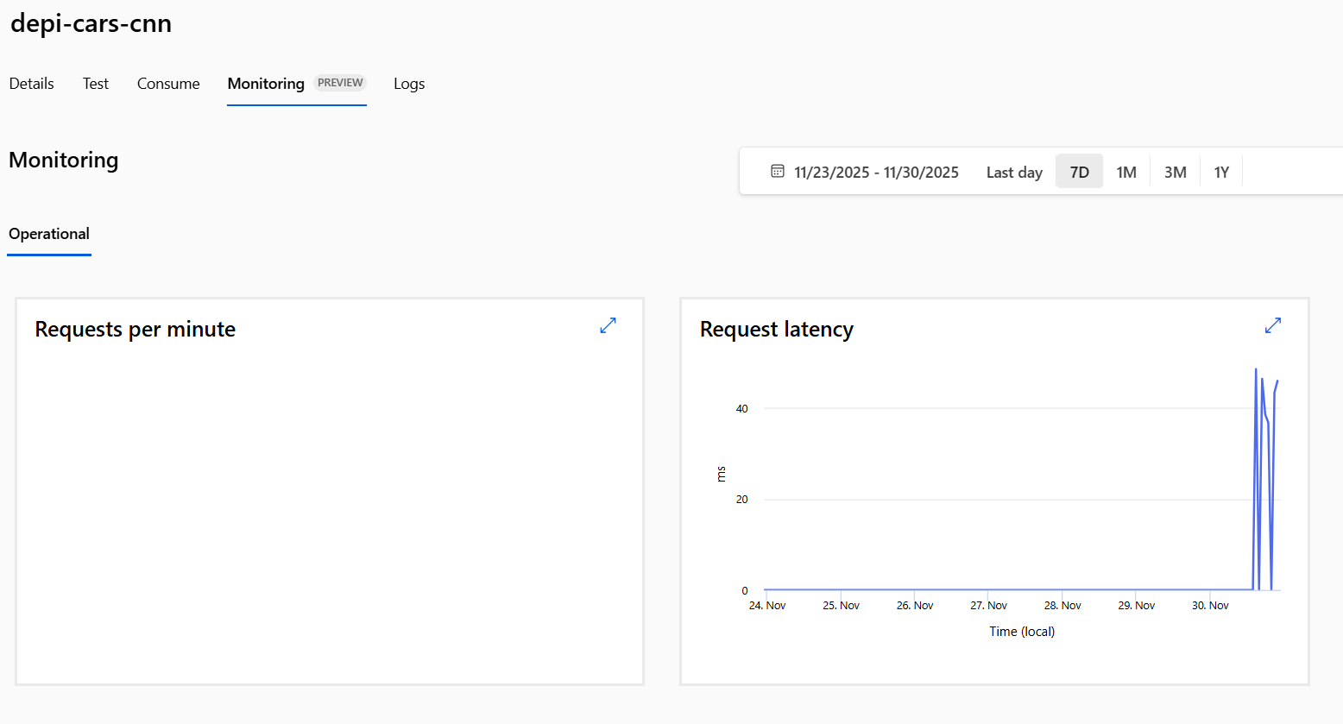
Azure Deployment Metrics:
11/29/2025

Slide 33
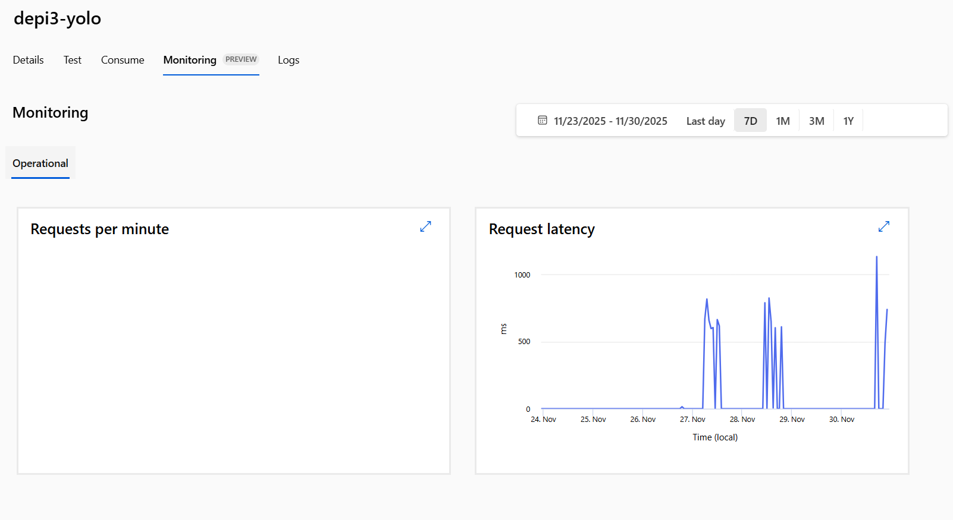
Azure Deployment Metrics:
11/29/2025

Slide 34
Web Interface (Frontend & API Integration)
11/29/2025

Slide 35
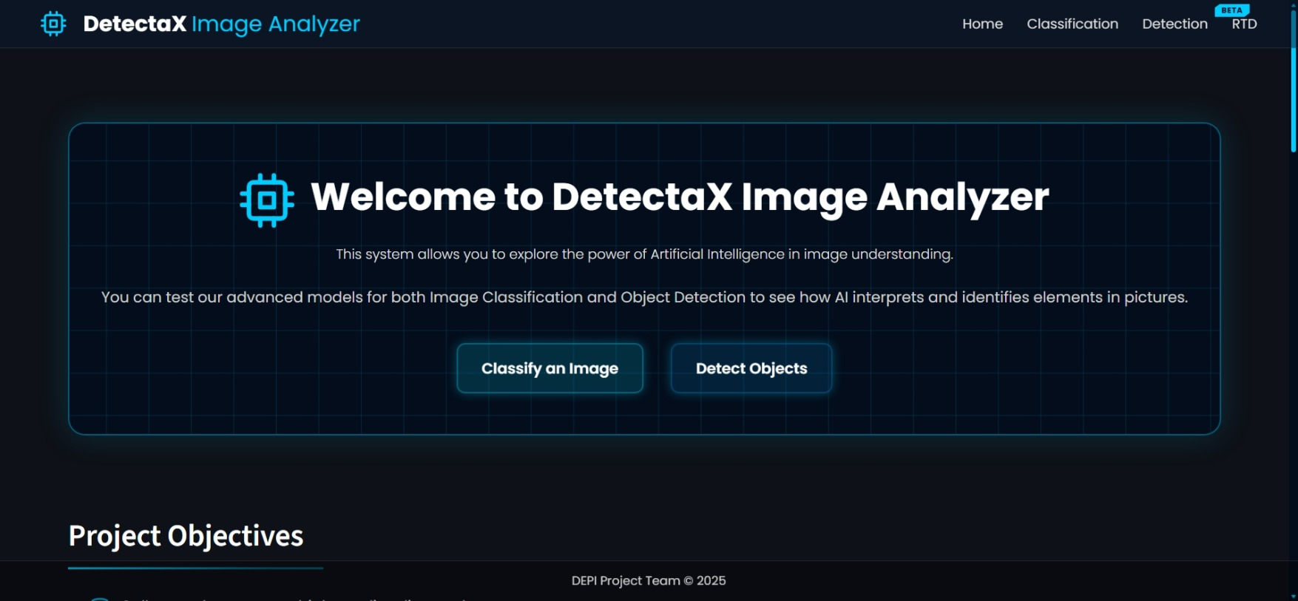
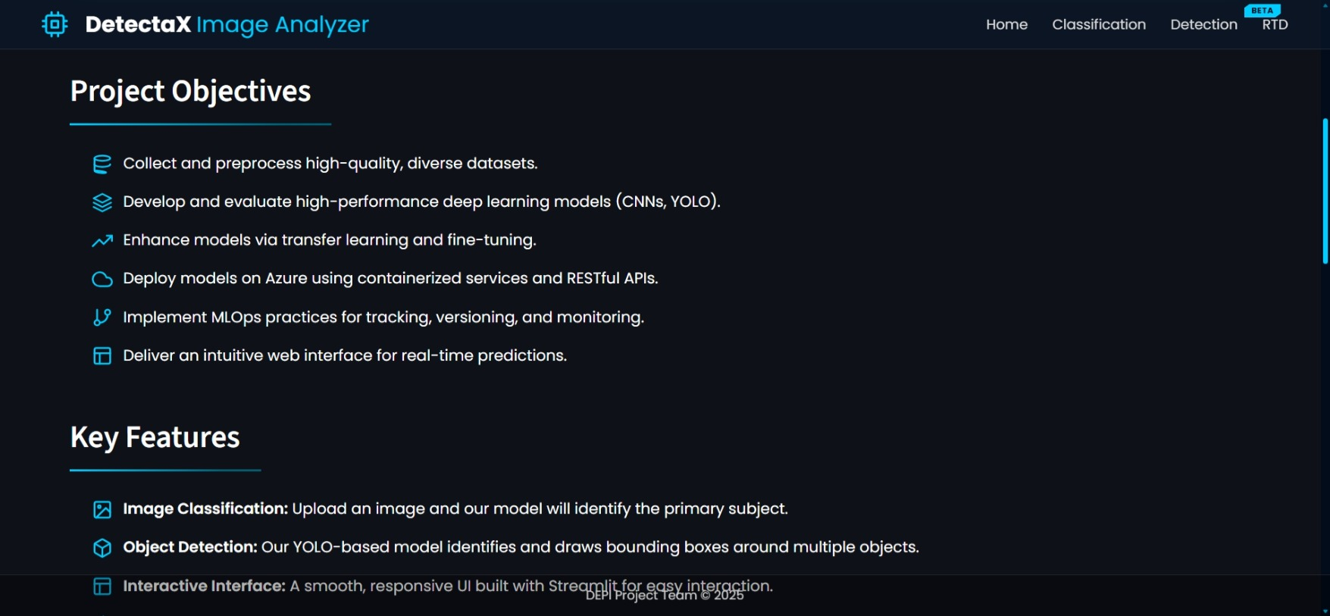
Web Interface Overview
Full interactive web interface built with Streamlit.
Supports image upload, batch processing, camera streaming, and real-time detection.
Unified dark glassmorphism theme with custom CSS.
Smooth navigation and consistent UI design across all modules.
11/29/2025

Slide 36
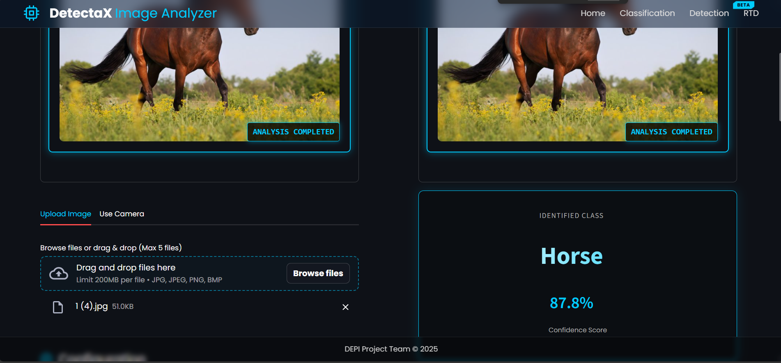
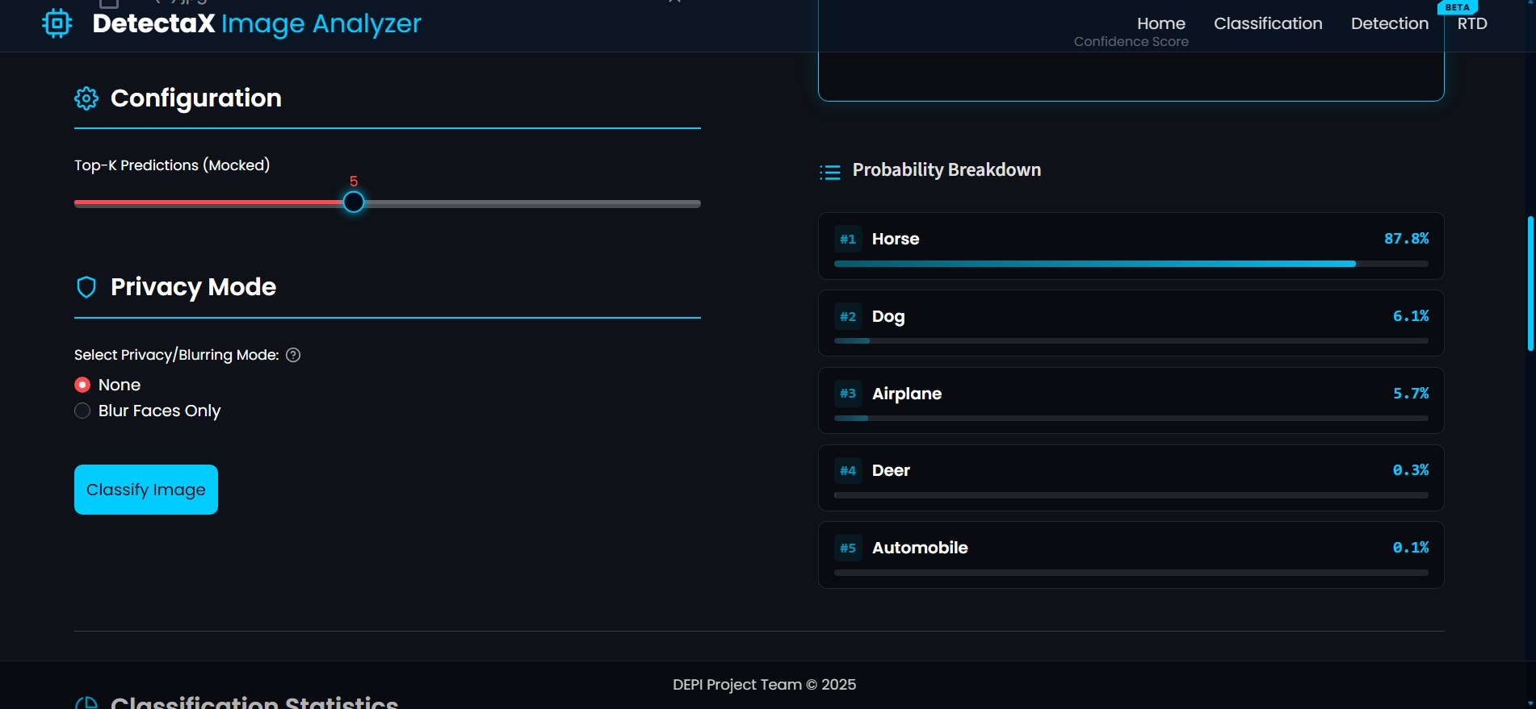
Image Classification Module
Upload single or multiple images (Batch Processing).
Automatic preprocessing and validation of all images.
Sends images to Azure CNN classification endpoint.
Displays predicted class, confidence score, and analytical charts.
Session history maintained for all processed images.
Stable fallback logic for handling API downtime.
11/29/2025

Slide 37
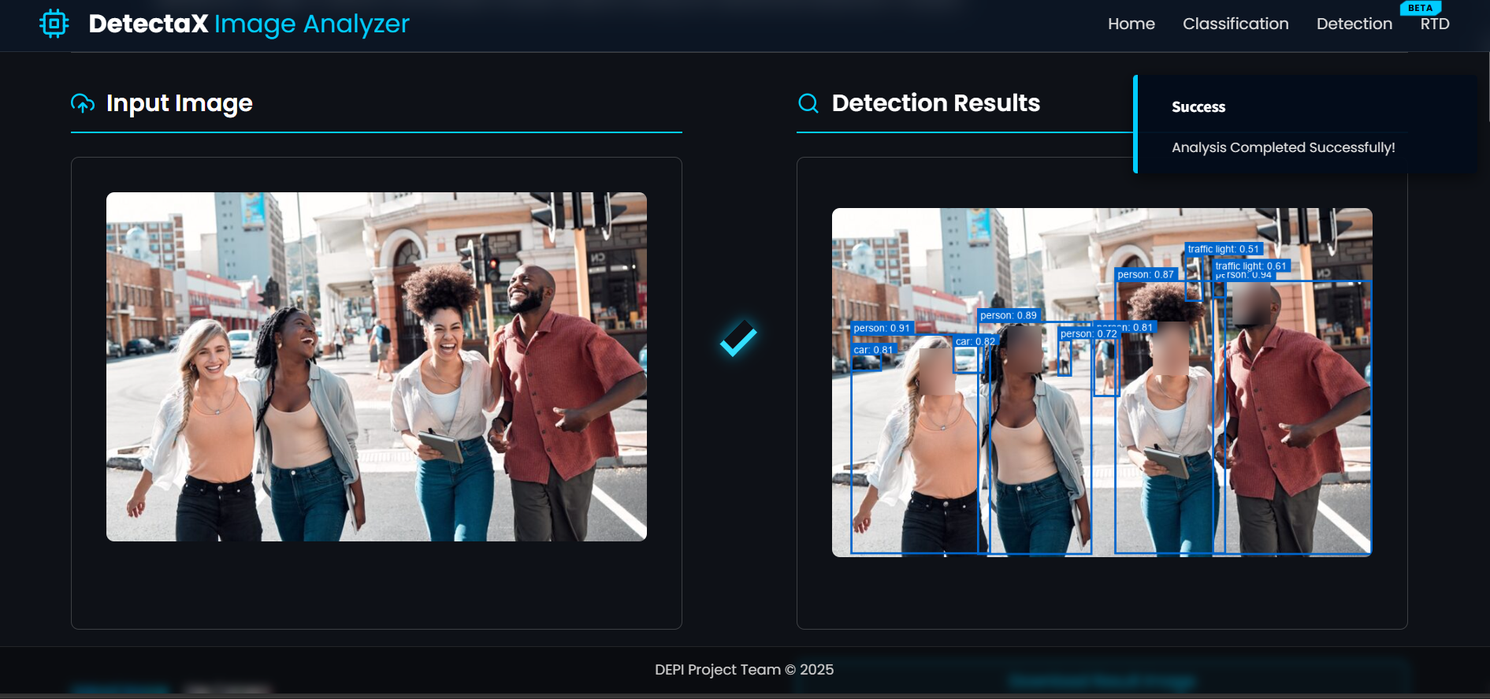
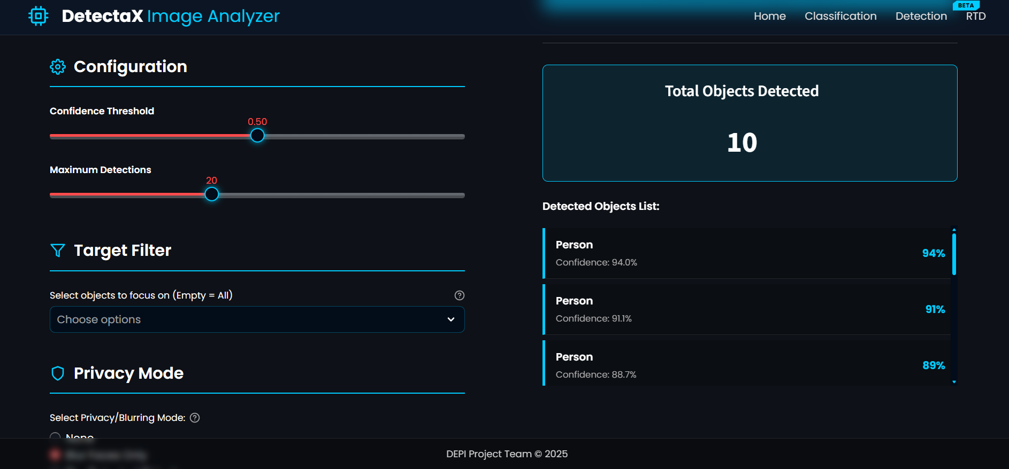
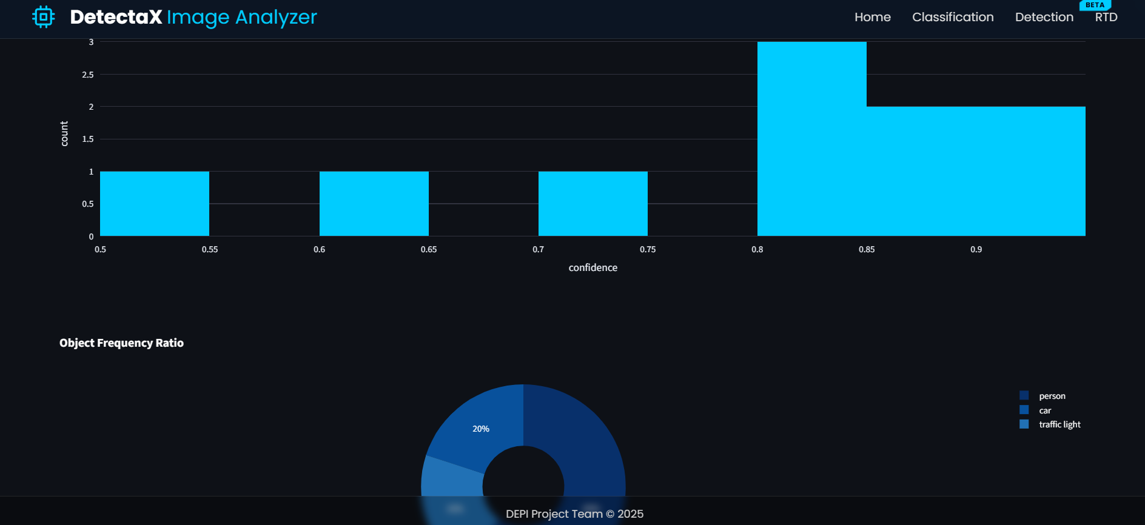
Object Detection Module
Supports single-image and multi-image detection (Batch Processing).
Performs detection using YOLOv12x via Azure cloud endpoint.
Adjustable confidence threshold and class filtering.
Custom bounding-box visualization with class-based colors.
Object cropping, ZIP export, PDF reporting, and detection analytics.
Clean, guided workflow for processing multiple images sequentially.
11/29/2025

Slide 38
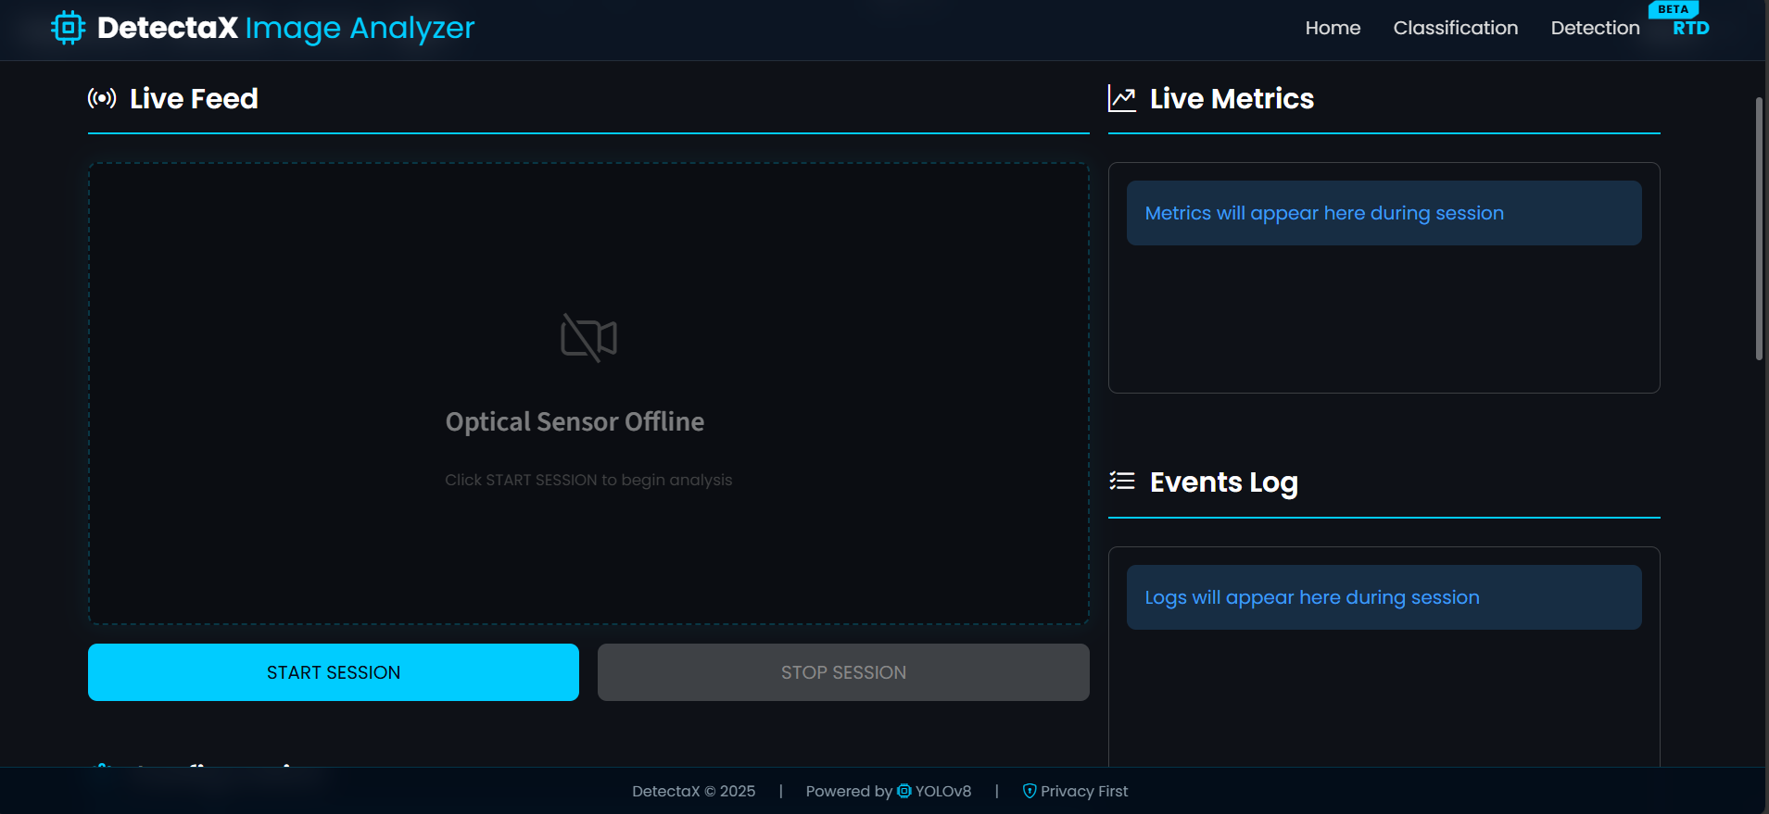
Real-Time Detection (RTD)
Real-time camera feed processing using OpenCV.
Continuous YOLOv12x inference per frame with FPS calculation.
Auto-snapshot capturing during the session.
Live statistics and dynamically updated charts.
11/29/2025

Slide 39
Real-Time Detection (RTD)
Real-time camera feed processing using OpenCV.
Continuous YOLOv12x inference per frame with FPS calculation.
Auto-snapshot capturing during the session.
Live statistics and dynamically updated charts.
11/29/2025

Slide 40
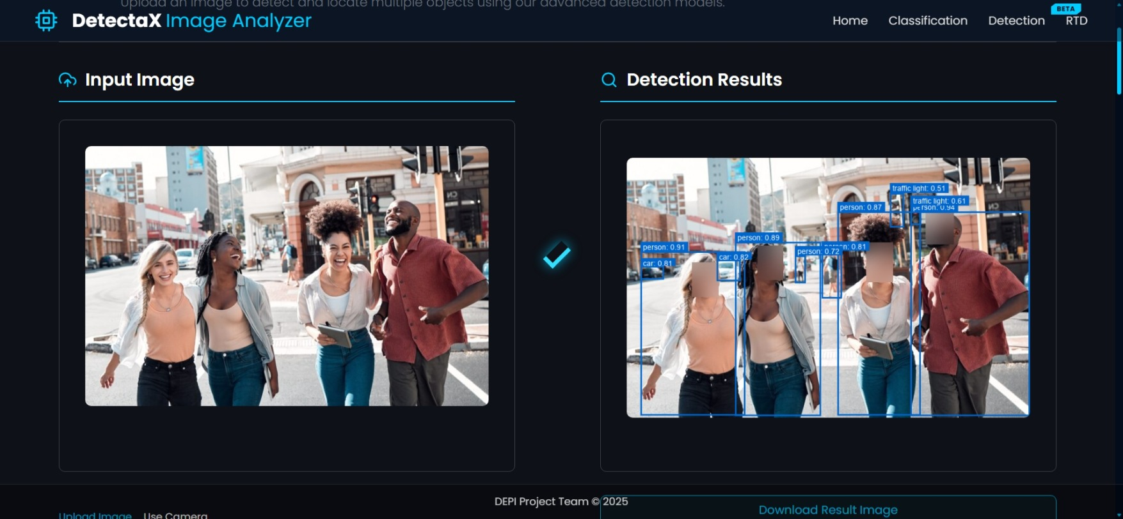
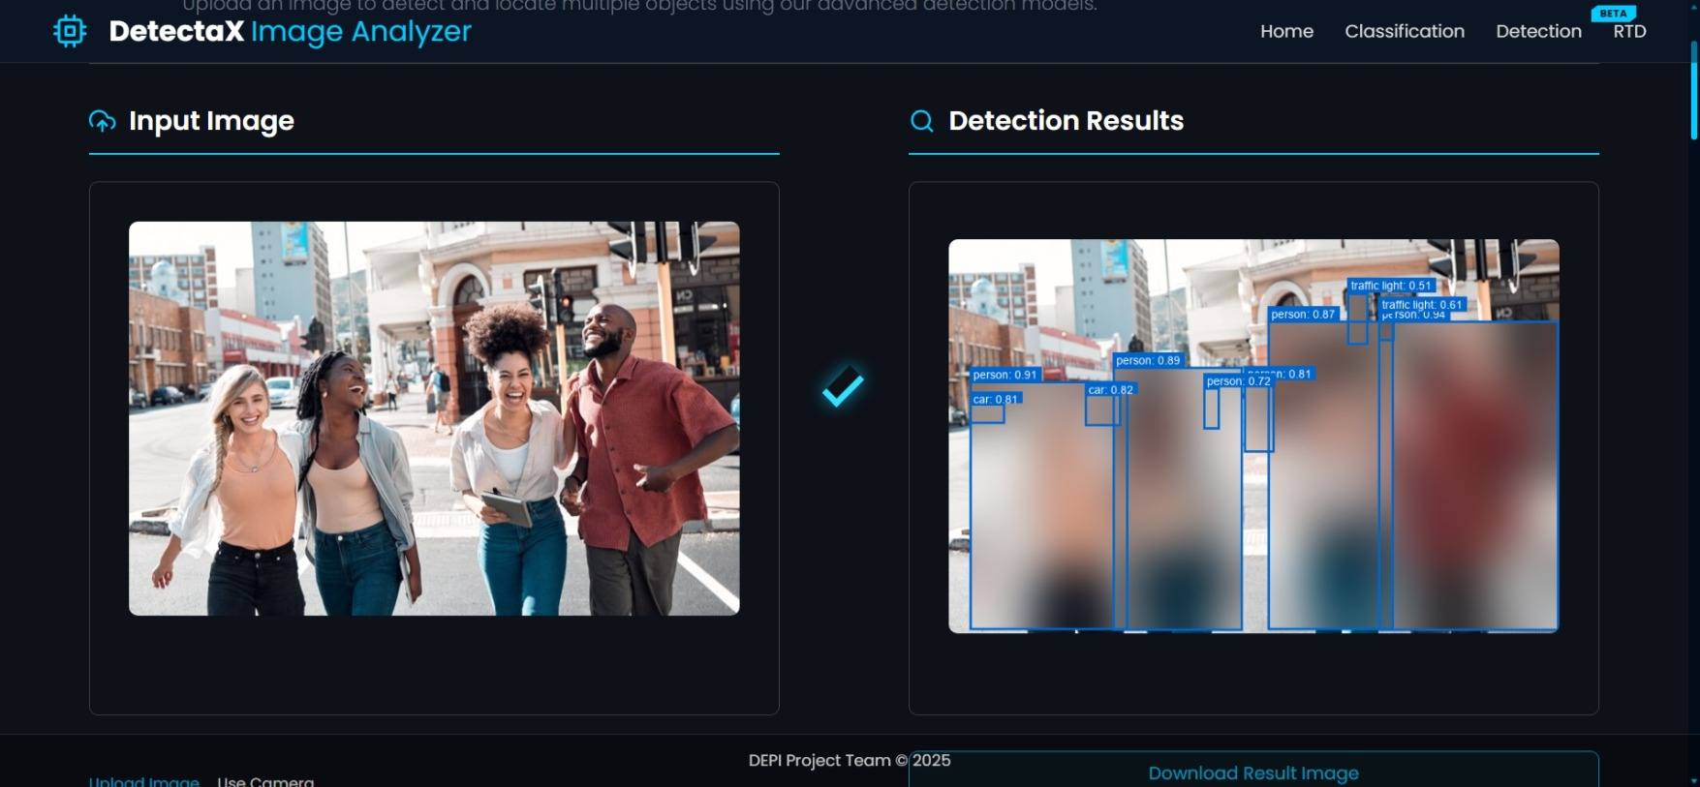
Smart Privacy System
(Blur Faces Only)
(Blur Detected Objects)
Optional privacy modes: face blur and full-person masking.
Utilizes YOLO-Face for accurate face detection.
Selective blurring without affecting full frame.
Available in both static image detection and real-time mode.
11/29/2025

Slide 41
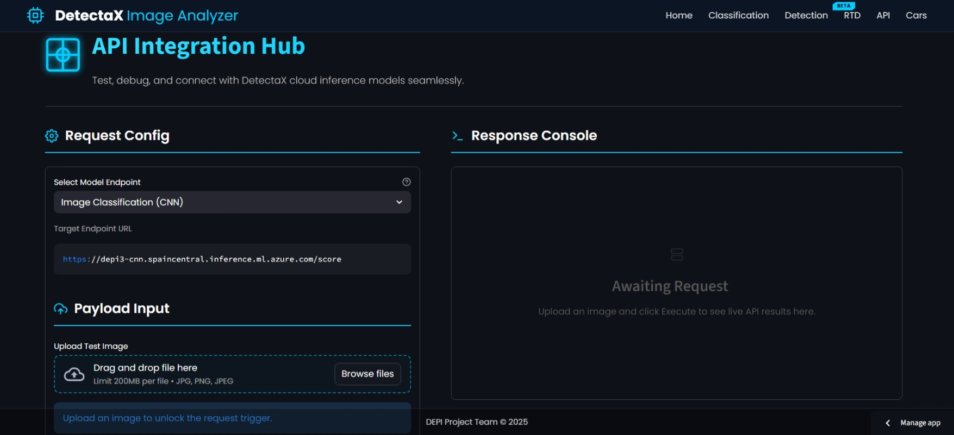
API Integration:
Key Points About the API Integration Hub Allows testing and debugging of the DetectaX cloud AI models.
1. Supports image upload for real-time inference.
2. Provides a clean interface to send requests and view API responses.
3. Enables selection of different model endpoints (e.g., Image Classification CNN).
4. Helps developers validate the model output before integrating it into applications.
5. Displays the live response in the console after executing the request.
11/29/2025

Slide 42
Project Demonstration
11/29/2025

Slide 43
Thank You!
11/29/2025

